Slide 1


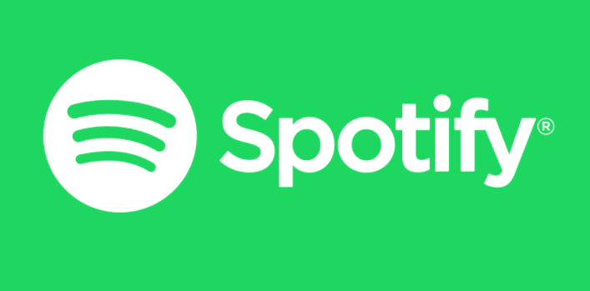
My Spotify Listening Data (August 2019 – July 2020)
Kalin Malchev

Slide 2


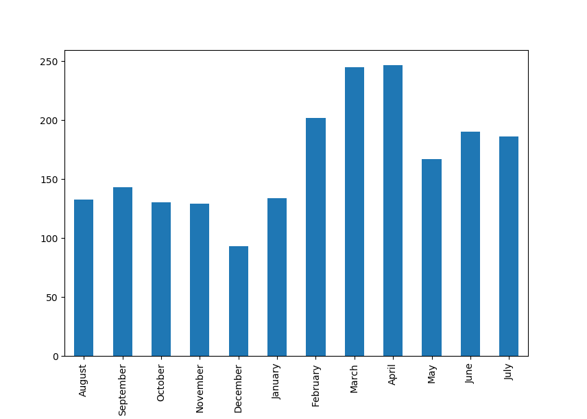
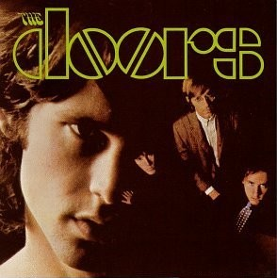
How Much Do I Listen? (Hours)
Total Time in the past year: 2001h
Average per day: 5h 29m
Hours Per month:
August 132.85
September 143.42
October 130.31
November 129.30
December 93.12
January 133.82
February 202.11
March 244.85
April 246.96
May 167.23
June 190.49
July 186.43
December was least listened month (93 hours in total) with 3 hours per day on average. I was overseas during this month.
April was most listened month (247 hours in total) with 8 hours and 14 min per day on average. This is about when the lockdown for Covid started.

Slide 3
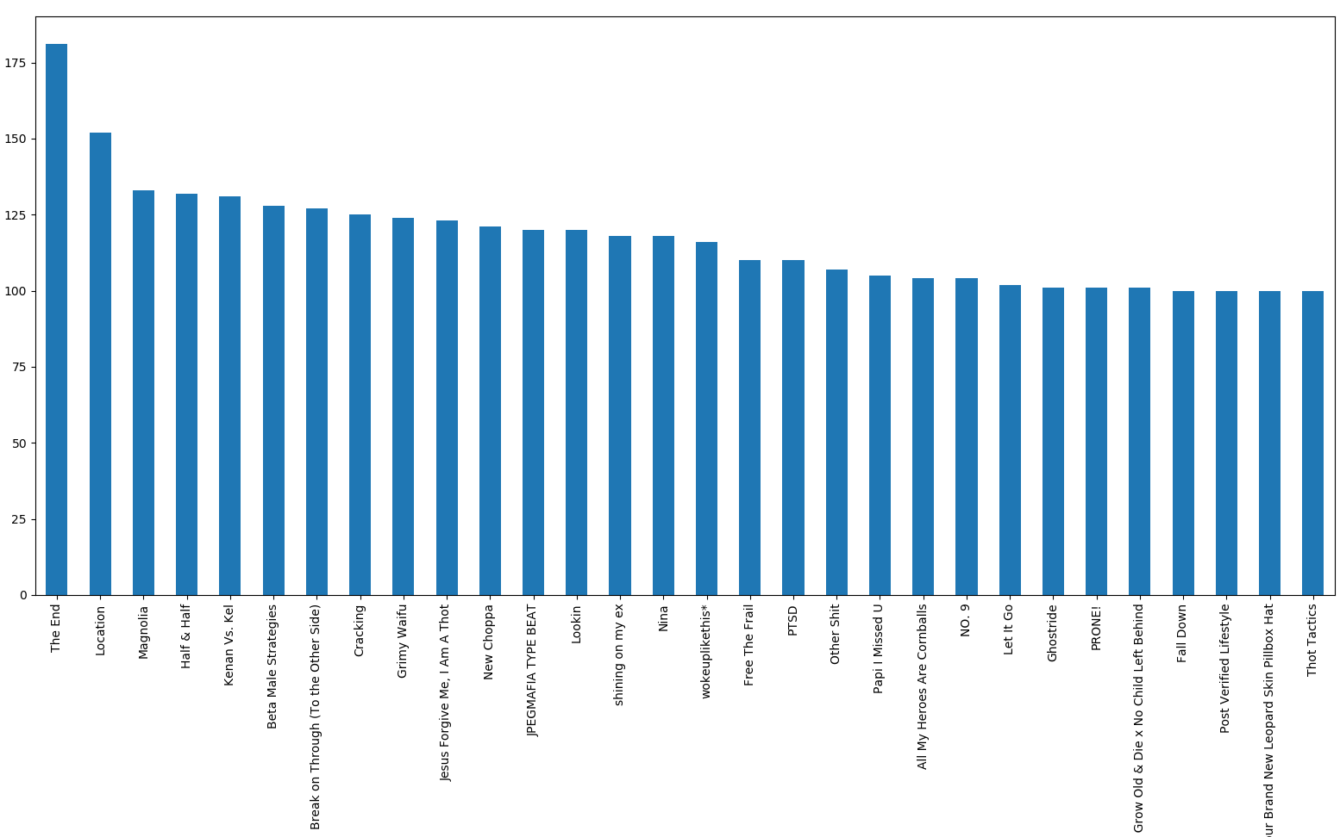
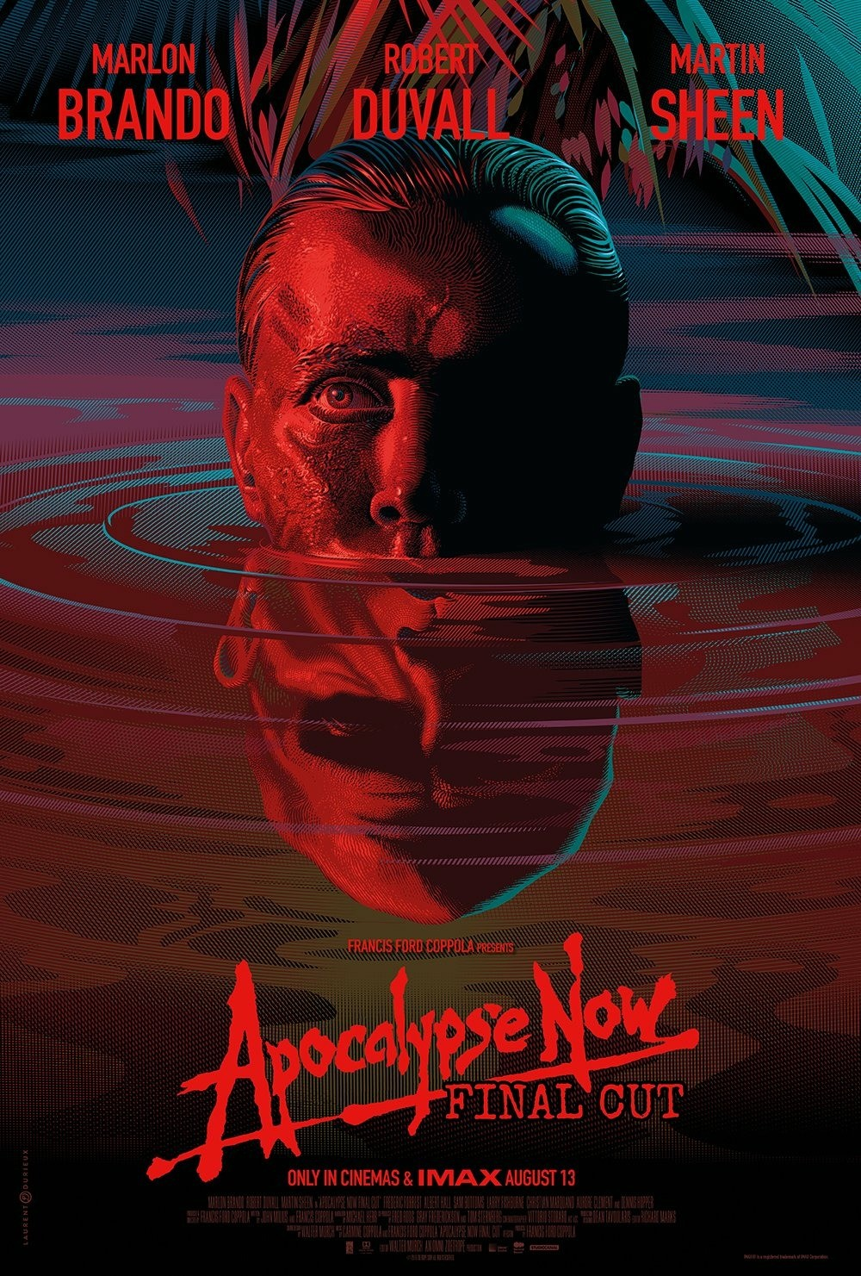
Most Listened Songs
The End 181
Location 152
Magnolia 133
Half & Half 132
Kenan Vs. Kel 131
Beta Male Strategies 128
Break on Through (To the Other Side) 127
Cracking 125
Grimy Waifu 124
Jesus Forgive Me, I Am A Thot 123
New Choppa 121
JPEGMAFIA TYPE BEAT 120
Lookin 120
Nina 118
shining on my ex 118
wokeuplikethis* 116
PTSD 110
Free The Frail 110
Other Shit 107
Papi I Missed U 105
NO. 9 104
All My Heroes Are Cornballs 104
Let It Go 102
Rap Grow Old & Die x No Child Left Behind 101
Ghostride 101
PRONE! 101
Fall Down 100
You Might Think He Loves You for Your Money but I Know What He Really Loves You for It's Your Brand New Leopard Skin Pillbox Hat 100
Post Verified Lifestyle 100
Thot Tactics 100
My most listened song was The End by The Doors, released in 1967 and is 11min 43seconds long. My favourite movie, Apocalypse Now (1979), had a 40th anniversary remaster in 2019 and after watching that in cinemas I really liked the music in the movie, particularly the song, The End.
It was interesting to me that my most listened song was that long and that it was by my 7th most listened artist overall.

Slide 4
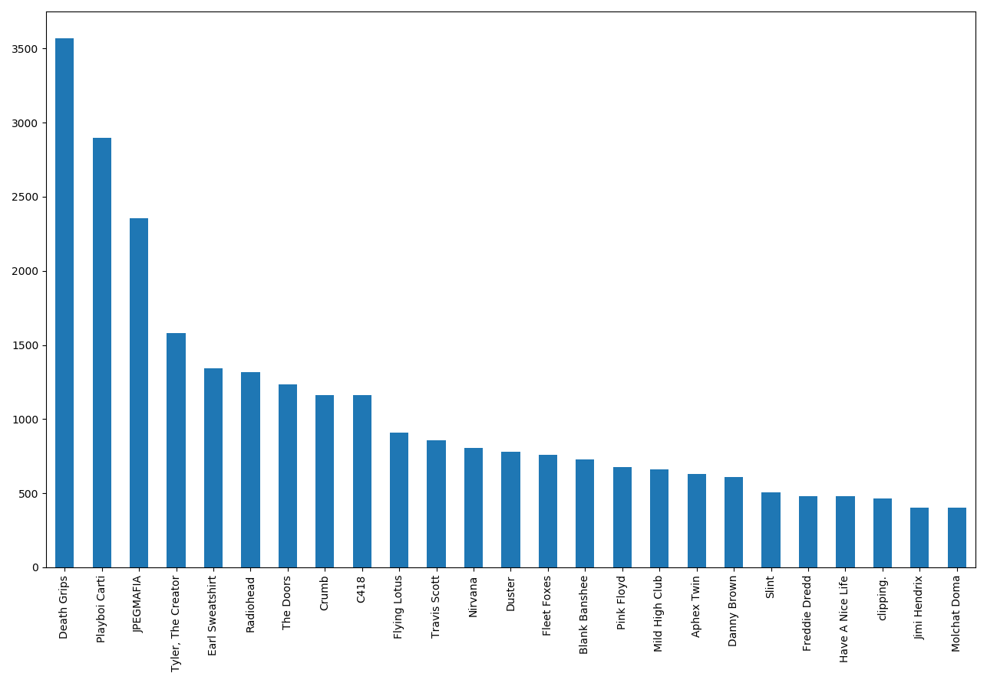
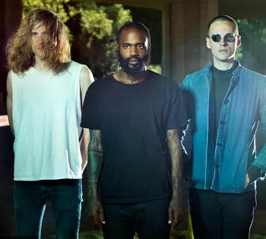
Who did I listen to the Most? (number of songs listened)
Death Grips 3571
Playboi Carti 2896
JPEGMAFIA 2354
Tyler, The Creator 1580
Earl Sweatshirt 1344
Radiohead 1315
The Doors 1236
Crumb 1163
C418 1162
Flying Lotus 910
Travis Scott 857
Nirvana 805
Duster 779
Fleet Foxes 758
Blank Banshee 730
Pink Floyd 678
Mild High Club 659
Aphex Twin 629
Danny Brown 611
Slint 507
Freddie Dredd 482
Have A Nice Life 478
clipping. 464
Jimi Hendrix 404
Molchat Doma 402
Most Listened was Death Grips →
The albums I listened to by my top 5 artists were all released between 2011-2019.
However 6th place (Radiohead) I listened to music released between 1995-2007.
And 7th place (The Doors) I listened to music released between 1967 and 1971.

Slide 5
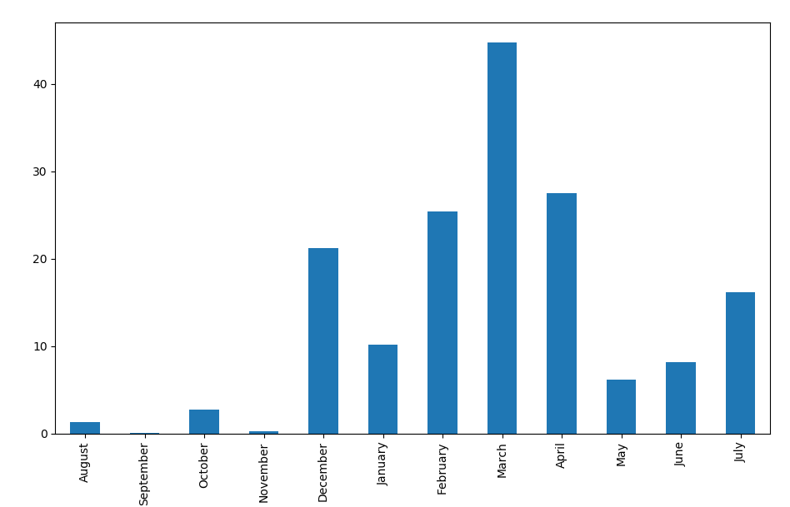

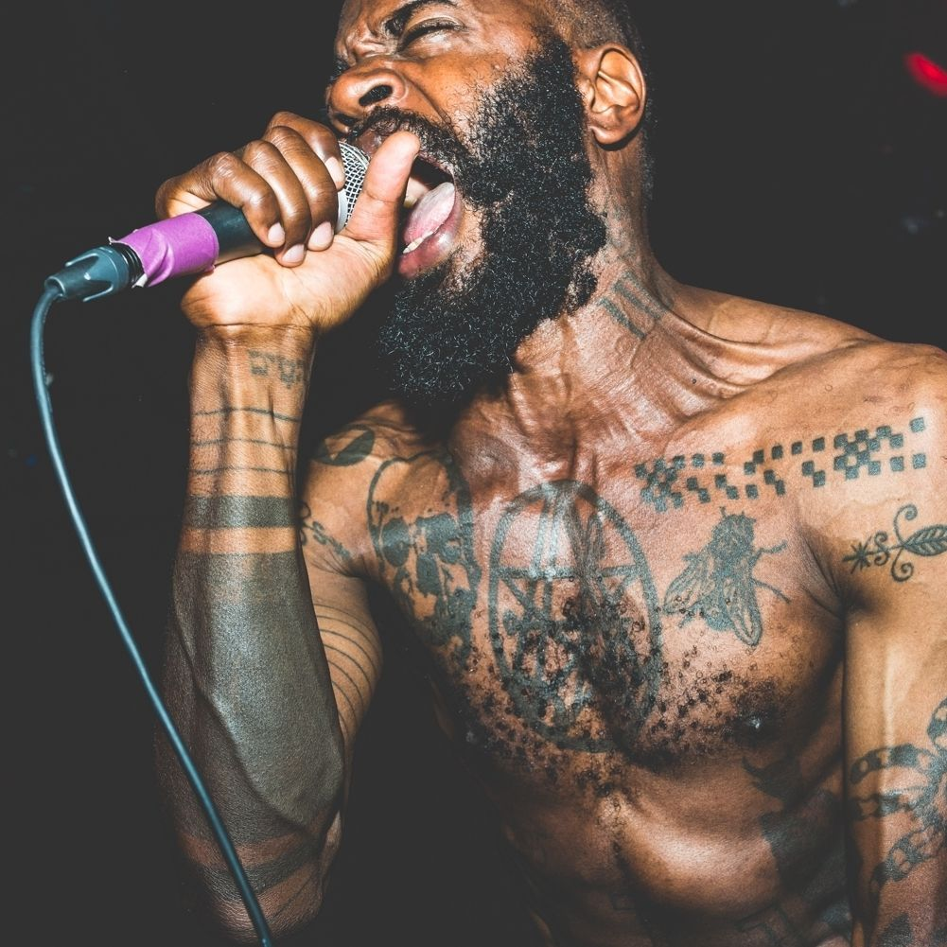
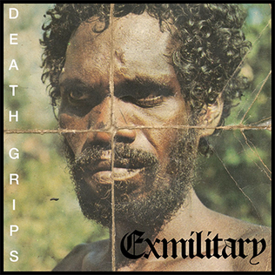

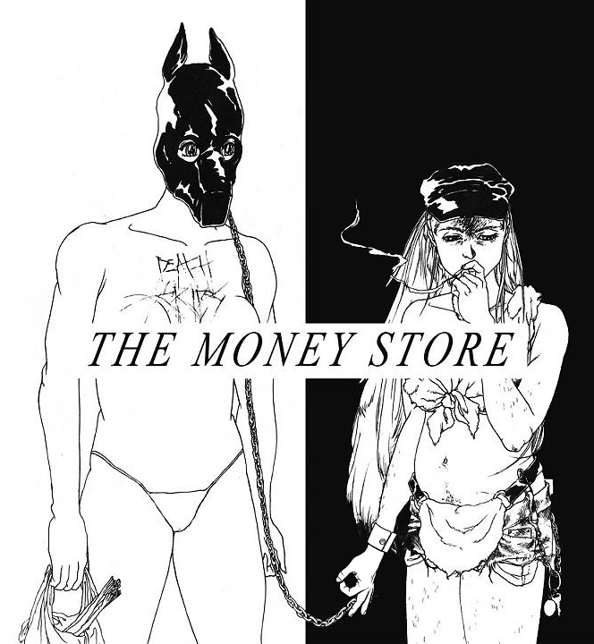
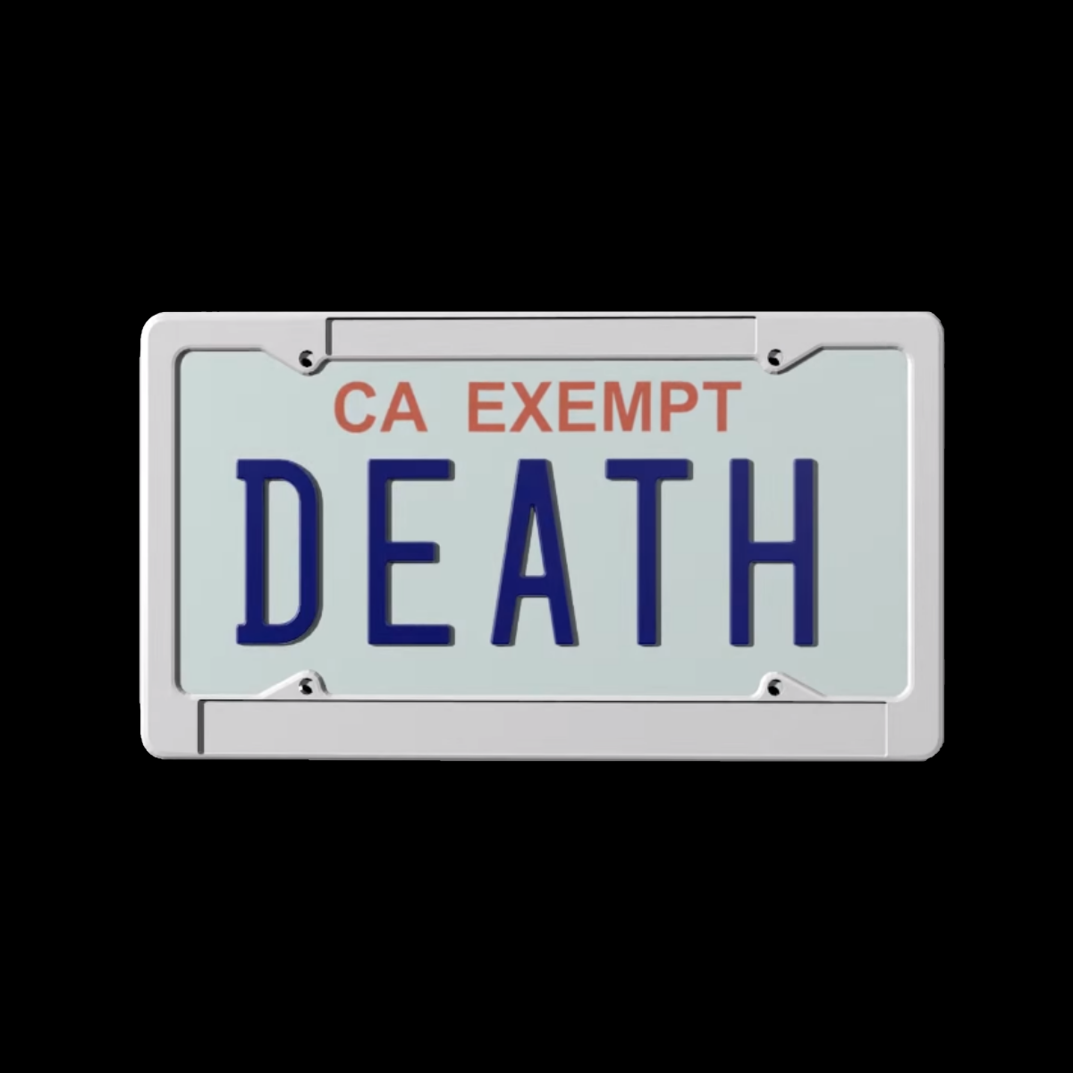
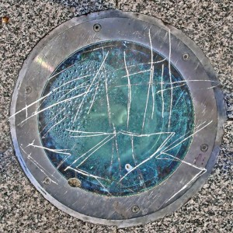


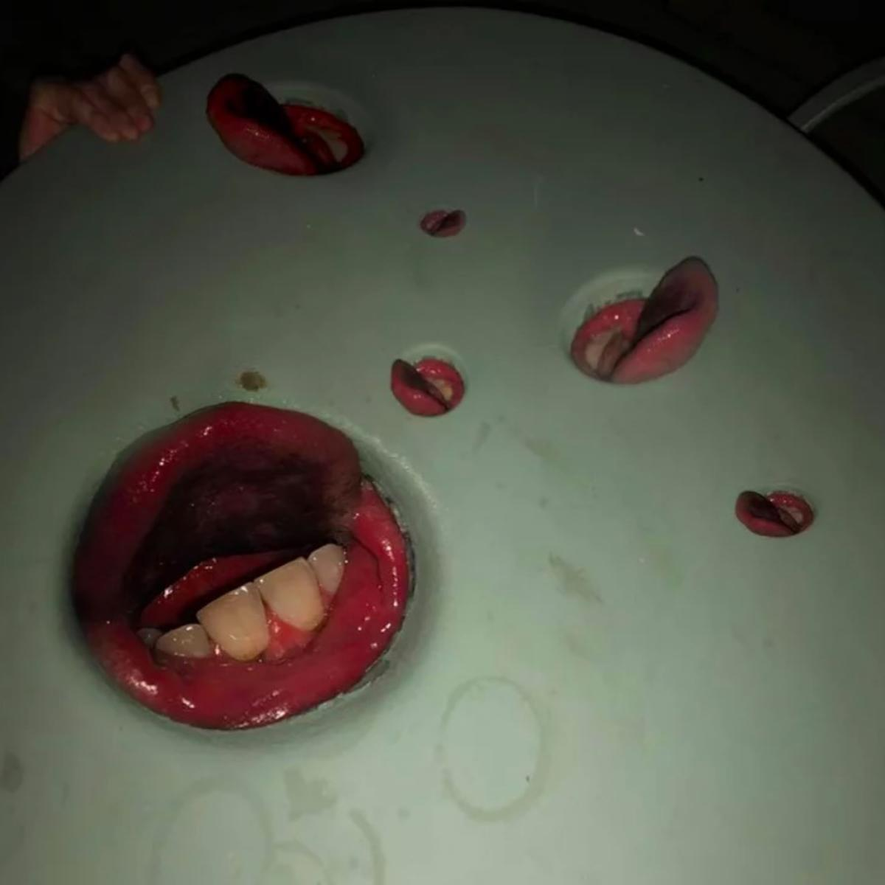
Artists Trends (Death Grips) Most listened (Hours)
I found Death Grips early 2019 and did not like their music originally and found it hard to listen to, but then during December 2019 I began listening to their music more and came to really appreciate it, particularly after learning more about them through various articles and YouTube videos, and became a big fan and they are my favourite and most listened artist as of now.
I also found it interesting that although they are my most listened artist, in the most listened songs graph, they first appear at 28th place This is because I listen to all of their music and don’t focus on particular songs. That song is titled: You Might Think He Loves You For Your Money But I Know What He Really Loves You For It's Your Brand New Leopard Skin Pillbox Hat

Slide 6
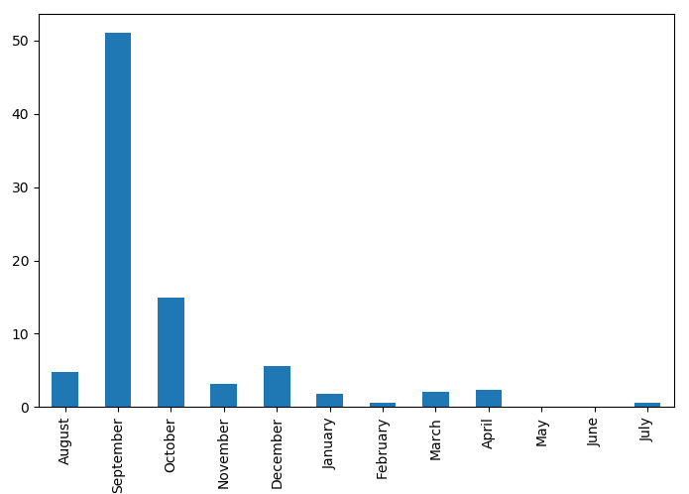
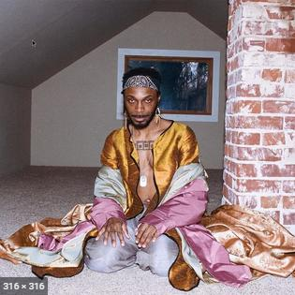
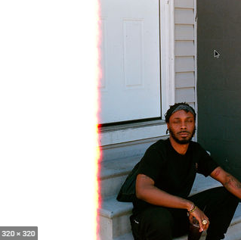
Artists Trends (JPEGMAFIA) – 3rd most listened (Hours)
JPEGMAFIA was my 3rd most listened artists and I had a large spike in September 2019 when JPEGMAFIA released his album All My Heroes Are Cornballs which I really liked and listened to a lot. However within about 2 months my listening hours declined rapidly
I found it interesting that the graph is somewhat of a mirror to the Death Grips graph, which is likely due to Death grips replacing them as my favourite artist
JPEGMAFIA VS Death Grips

Slide 7
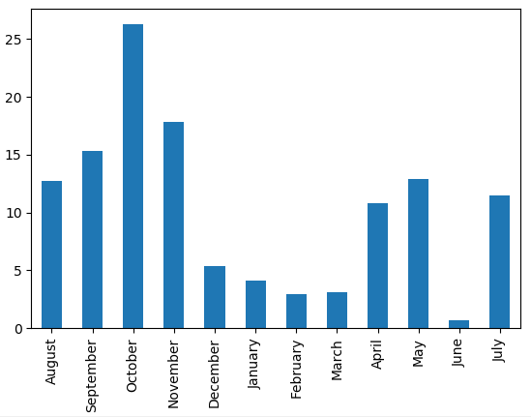
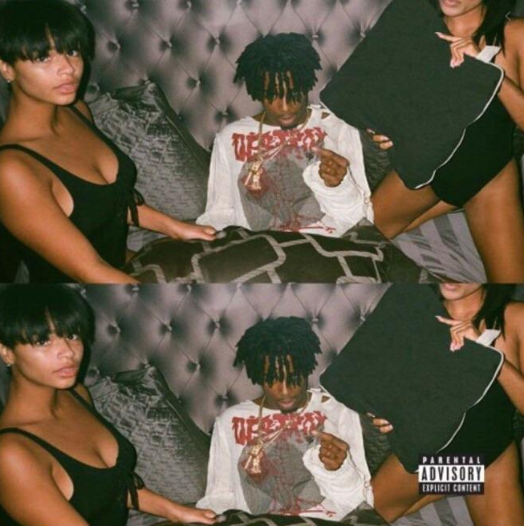
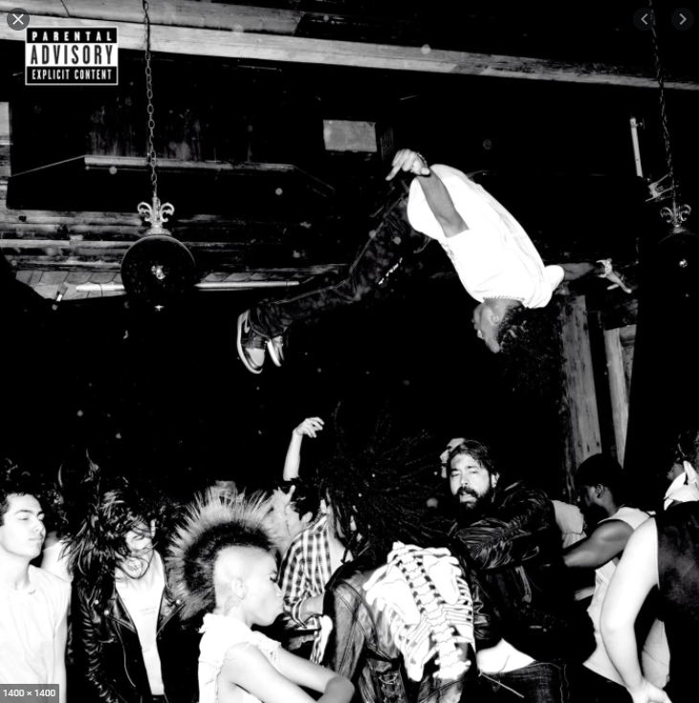
Artists Trends (Playboi Carti) 2nd most listened (hours)
Playboi Carti was my 2nd most listened artist and I found it interesting that there weren’t any huge spikes like Death Grips or JPEGMAFIA. My most listened month was October which was just over 25hours of listening time.
Even though there haven’t been any spikes, playtime has been fairly consistent compared to my other artists, and Playboi Carti’s songs dominate the most listened songs list. Likely due that there is one main album that I really enjoy of his.

